Slide 1


MIAD
Maestría
en Inteligencia Analítica de Datos

Slide 2



Decisiones sobre la fuerza de ventas y el canal de distribución
Caso: C-Tek Corporation
MIAD
Maestría
en Inteligencia Analítica de Datos
Sesión sincrónica
Ejercicio semana 7

Slide 3



C-Tek Corporation was founded in 1889 in Twin Harbors, Minnesota by seven businessmen determined to develop new materials for grinding wheels, sandpaper and abrasive products. Since its inception, the company’s lines of business expanded into numerous other, related areas, mainly centered around materials involving either adhesion or abrasion.
From its start in the late 1800's, the company grew entirely through internal innovation and growth to revenue of more than $20 billion in 2004. Each of the company’s 33 lines of business operates its own channels, mixing direct sales with an extensive set of distributor relationships. Each of these lines of business operates as a rather independent business unit, with its own revenue targets and profit and loss statements.
In August of 2004, John Sawyers, Sales Manager for the Grinding Products division of C-Tek, attended a seminar where he heard about a method for using managerial judgment to determine the best level of selling effort and how to allocate that selling effort. As his most recent proposals to add to his US salesforce of 52 had been denied, he felt that the “judgmental approach” might be just what he needed to build a more defensible case for an increase in his salesforce size.

Slide 4
John met with Professor Gary Lilien of Penn State. They discussed the need for careful background information-gathering, the assembling of a team of sales managers, sales representatives, marketing planners and product developers to be able to provide the data and environment for performing the analysis.
The base team identified several critical issues. First, they determined that the appropriate unit of analysis would be the sales branch. Sales representatives at Grinding Products work out of 14 sales branches in the US. Next, they decided to assume a “moderate” level of product development—no breakthrough products.
Two other critical issues involved the assumed length of the planning horizon. They chose a three-year horizon for all related data, assuming that this would be a reasonable length of time for any new hires or transfers to have their complete impact on the marketplace. The second critical item involved the assignment of an average profit margin to each of the sales branches. The team decided to use 0.35 as their “best guess”, but suggested that Lilien run the analysis with margins running from 0.20 (worst case) to 0.45 (very optimistic). The average, fully loaded cost for a sales rep at C-Tek was projected to be $147,000.

Slide 5
They organized a calibration session for early February 2005. After a 1-1/2 hour introduction session, the group broke into four subgroups, each of which built a sales response function for three to four sales branches, by essentially answering the following questions:
What would sales be in three years at this branch with: a) No sales force representation? b) One fewer sales representative? c) The same number of sales representatives? d) One more sales representative? e) A very large increase in the number of sales representatives?

Slide 6
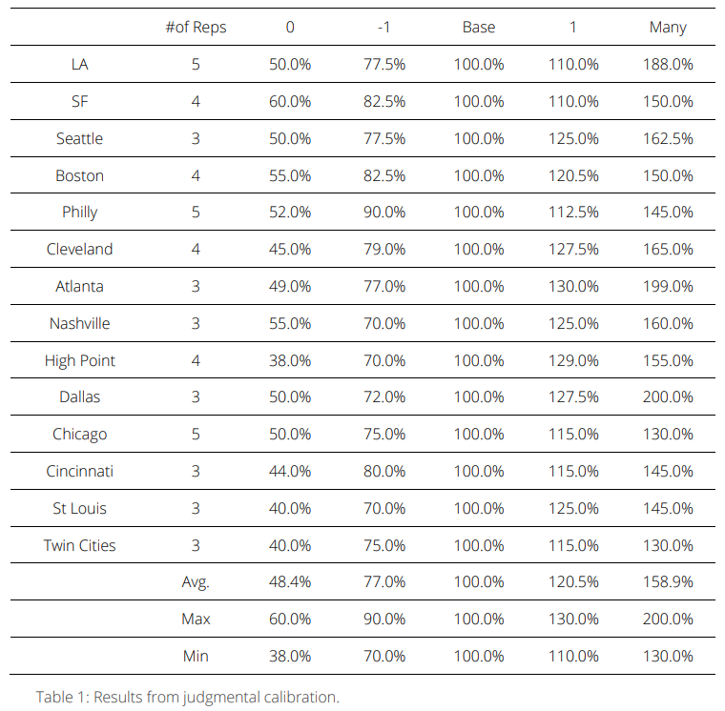
0 means: no selling effort in that sales branch
-1 means: 1 sales person fewer than the current level of selling effort
+1 means: 1 sales person more than the current level of selling effort
Many means: unlimited selling effort available in that sales branch

Slide 7
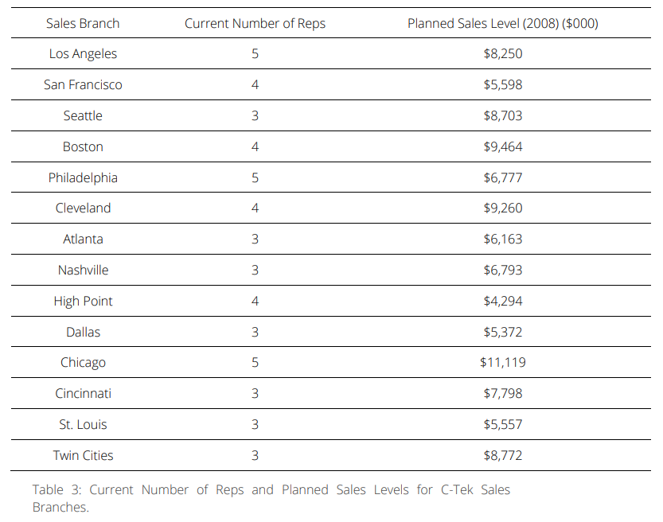

Slide 8
The Resource Allocation model provides a general approach to the sizing and allocating problem. Because of its generalizability, that model can be adapted for use by various multiproduct, multisegment firms that employ a field sales force.
Question 1
Using the base data, run analyses for C-Tek, both for an unconstrained analysis and for a fully constrained analysis (reallocation). Develop sensitivity analyses concerning profit margin as well. What alternatives and options does this analysis suggest?
R. All reports contain the unconstrained analysis so here we have set the global maximum effort to 52 to produce constrained results as well.

Slide 9
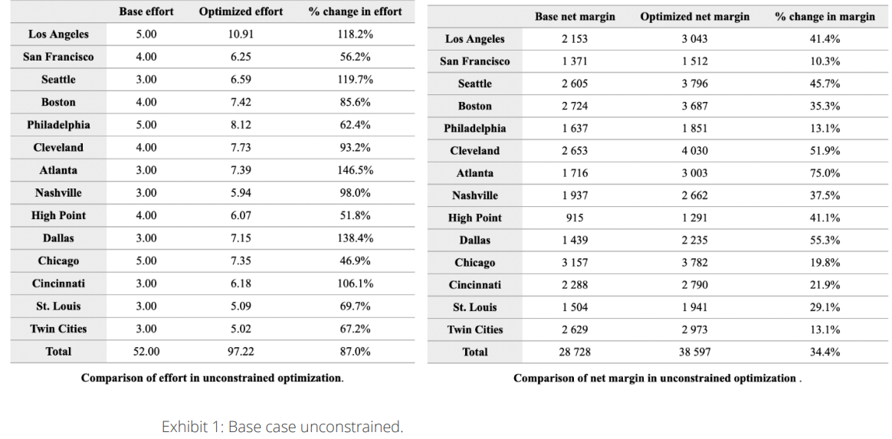
Exhibit 1 shows the unconstrained results in which there appears to be a net margin potential of $38.6MM-$28.7MM or $9.9MM (34.4% gain). This profit gain requires 97 sales reps, an addition of 45 (87% increase) from the base of 52.

Slide 10
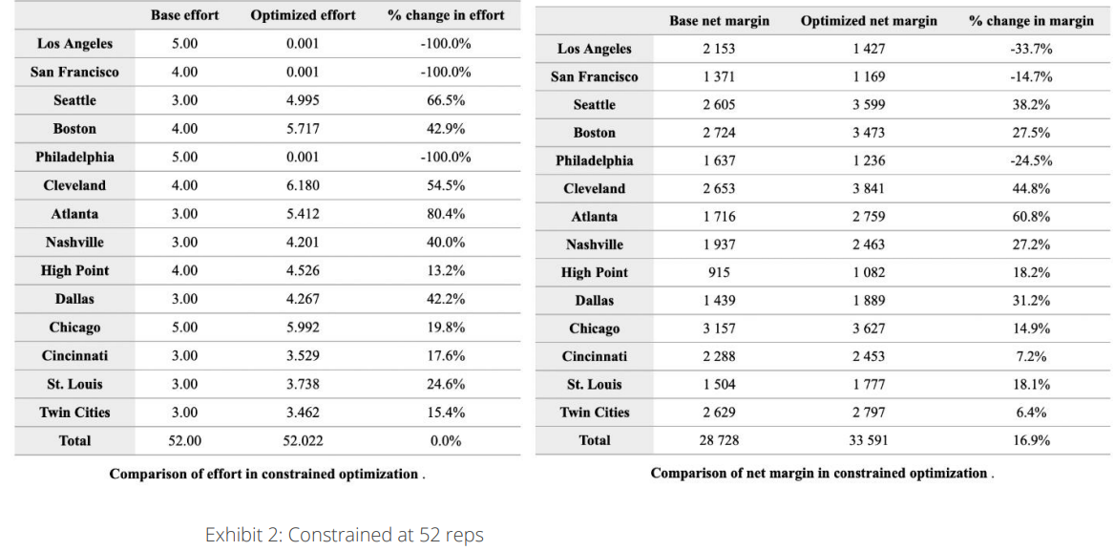
Exhibit 2 shows the Base Case constrained at the current level of selling effort, 52 reps. Such a pure reallocation of effort could lead to a net margin increase of $33.6MM less $28.7MM or $4.9MM, equating to a 16.9% gain. Hence, half of the 34.4% potential gain cited above could be achieved with NO increase in sales staff, but simply by reallocating existing resources. Seattle, Cleveland, and Atlanta seem to be the branches with the most upside potential, with Los Angeles, San Francisco, and Philadelphia apparently the most attractive sources for reduction.

Slide 11
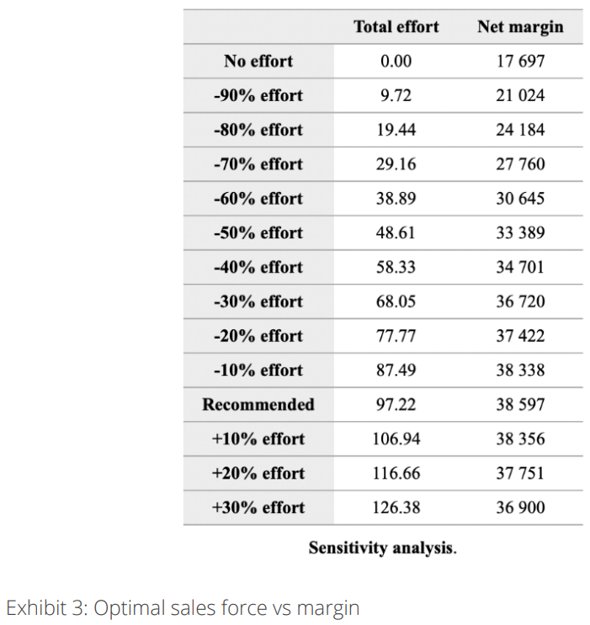
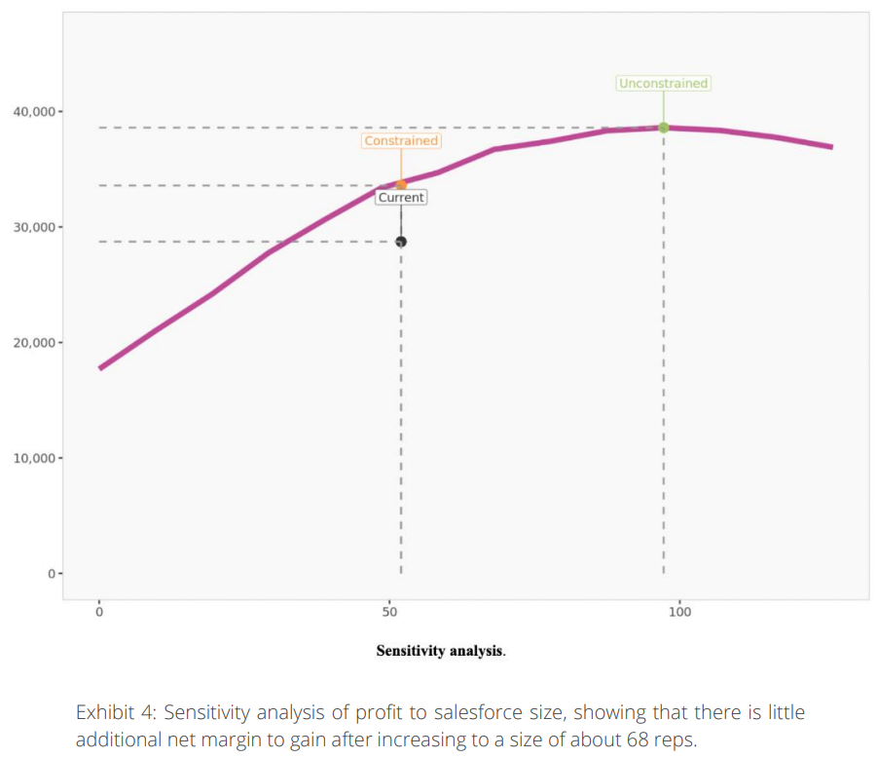
Exhibit 3 shows the sensitivity of the unconstrained optimal sales force size to the (projected) profit margin for the firm. And Exhibit 4 shows how projected profitability increases steeply up to a level of about 68 sales reps and then seems to level off. This observation shows that after 68 sales reps there is not much to gain OR much to lose financially from adding staff. Hence, a reasonable case could be made for increasing to a target of 68 reps (see Exhibit 5 which is created by re-running the analysis with a constraint of 68); it is much more difficult to support a case for the model "optimum" of 97.

Slide 12
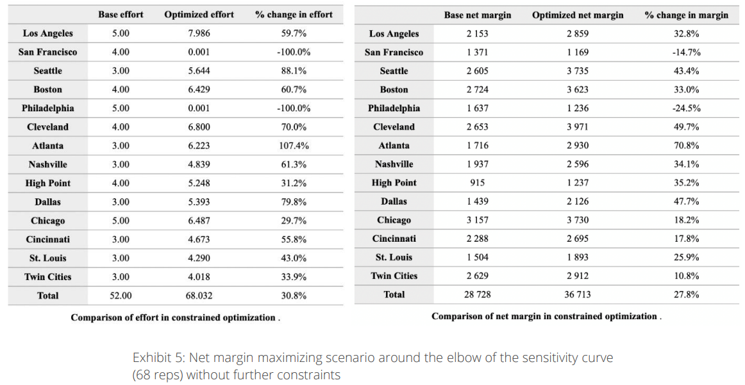

Slide 13
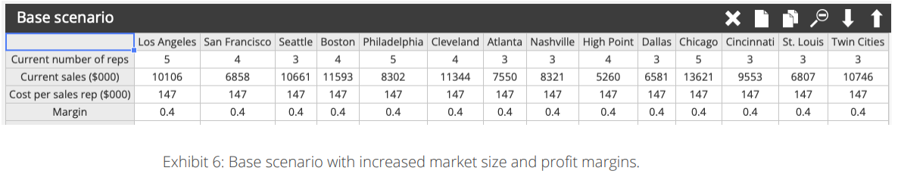
Question 2
Product development has a breakthrough technology that they claim will increase the size of the market by 20-25% with average profit margins approaching 40% for the full line of products. What would the impact of such a scenario be on your results and recommendations from Q1?
R. To account for the increased market size and profit margins, we must adjust the Base Scenario (Exhibit 6) in Enginius to the following: increase the current sales in each market by 22.5% (a middle ground to the 20-25% expected increase) and increase the margin to 40%.

Slide 14
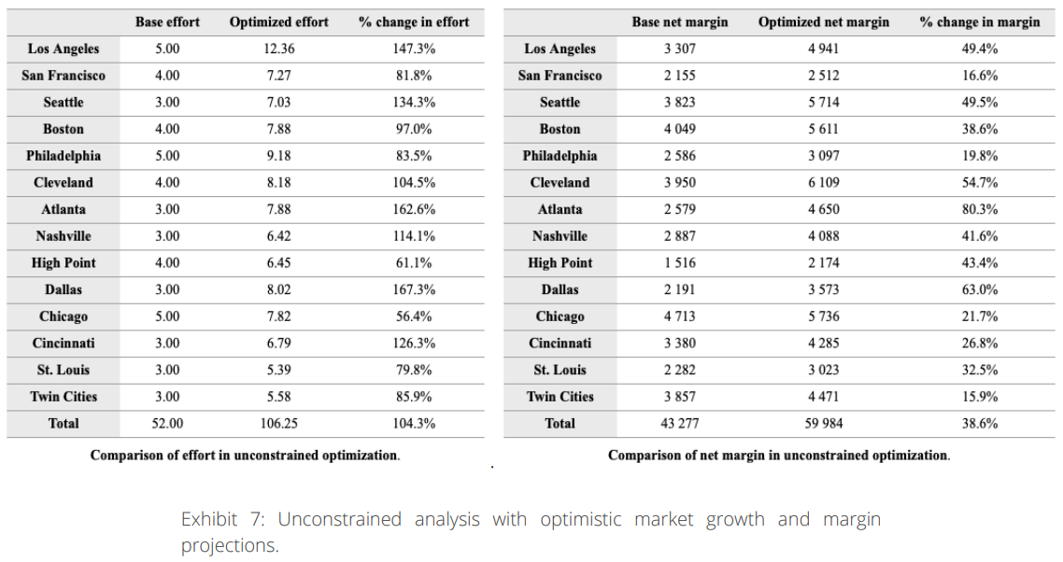
The unconstrained analysis in Exhibit 7 suggests an optimal salesforce size of 106 without constraints and an upside total net margin opportunity of $60MM - $43.3MM or $16.7MM (or 39%). Of that amount $50.1-$43.3 or $6.8MM (or 40%) of the gain can be attributed to reallocation as seen in Exhibit 8.

Slide 15
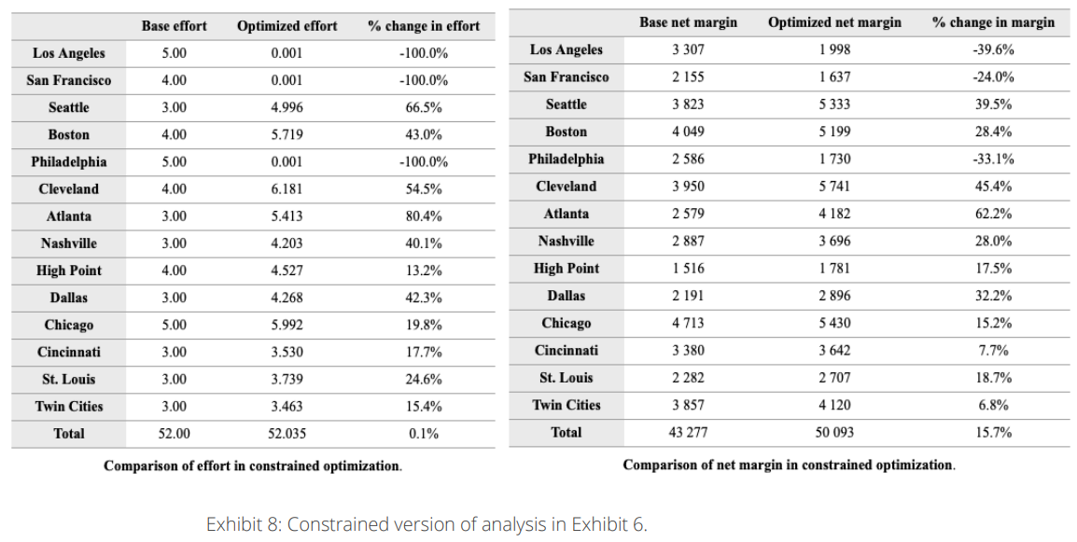

Slide 16
Question 3
What would you recommend and why?
R. There are many good answers here, but the best will involve:
1. Recognition of gains to reallocation versus gains to size increase. 2. Tentative long term plans (3 years out), with benchmarks and reassessment points annually at least. 3. Understanding that these are staffing and people issues and that people may not be easy to move.

Slide 17


Marketing
Analytics
MIAD
Maestría
en Inteligencia Analítica de Datos

